Slide 1

Bagging and Boosting
Copyright © www.ITbodhi.com

Slide 2
Bagging and Boosting
Bagging and Boosting are similar in that they are both ensemble techniques, where a set of weak learners are combined to create a strong learner that obtains better performance than a single one.
Copyright © www.ITbodhi.com

Slide 3
ENSEMBLE LEARNING
Ensemble methods combine several decision trees classifiers to produce better predictive performance than a single decision tree classifier. The main principle behind the ensemble model is that a group of weak learners come together to form a strong learner, thus increasing the accuracy of the model.
When we try to predict the target variable using any machine learning technique, the main causes of difference in actual and predicted values are noise, variance, and bias. Ensemble helps to reduce these factors (except noise, which is irreducible error).
Copyright © www.ITbodhi.com

Slide 4
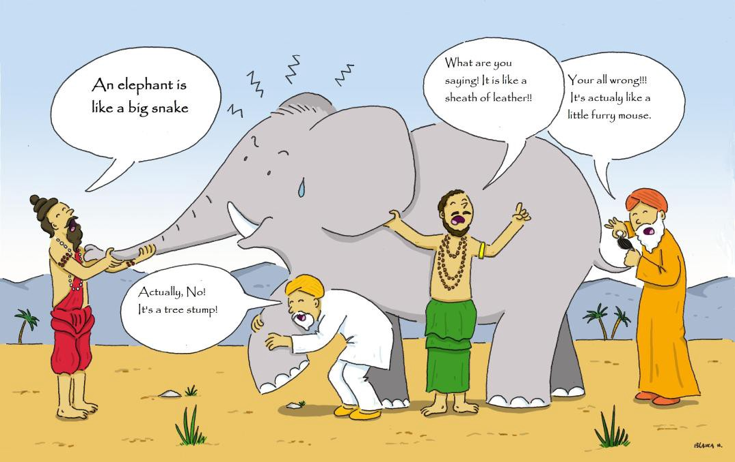
Copyright © www.ITbodhi.com

Slide 5
Using techniques like Bagging and Boosting helps to decrease the variance and increased the robustness of the model.
Combinations of multiple classifiers decrease variance, especially in the case of unstable classifiers, and may produce a more reliable classification than a single classifier.
Copyright © www.ITbodhi.com

Slide 6
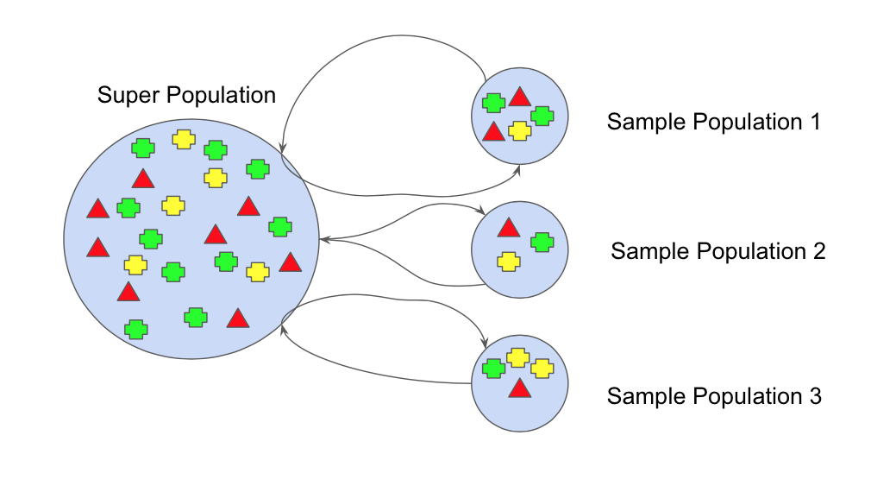
BOOTSTRAPPING
Bootstrap refers to random sampling with replacement. Bootstrap allows us to better understand the bias and the variance with the dataset.
Bootstrap involves random sampling of small subset of data from the dataset.
This subset can be replaced.
The selection of all the example in the dataset has equal probability.
Copyright © www.ITbodhi.com

Slide 7
BAGGING
Bootstrap Aggregation (or Bagging for short), is a simple and very powerful ensemble method. Bagging is the application of the Bootstrap procedure to a high-variance machine learning algorithm, typically decision trees.
Suppose there are N observations and M features. A sample from observation is selected randomly with replacement(Bootstrapping).
A subset of features are selected to create a model with sample of observations and subset of features.
Feature from the subset is selected which gives the best split on the training data.
This is repeated to create many models and every model is trained in parallel
Prediction is given based on the aggregation of predictions from all the models.
Copyright © www.ITbodhi.com

Slide 8
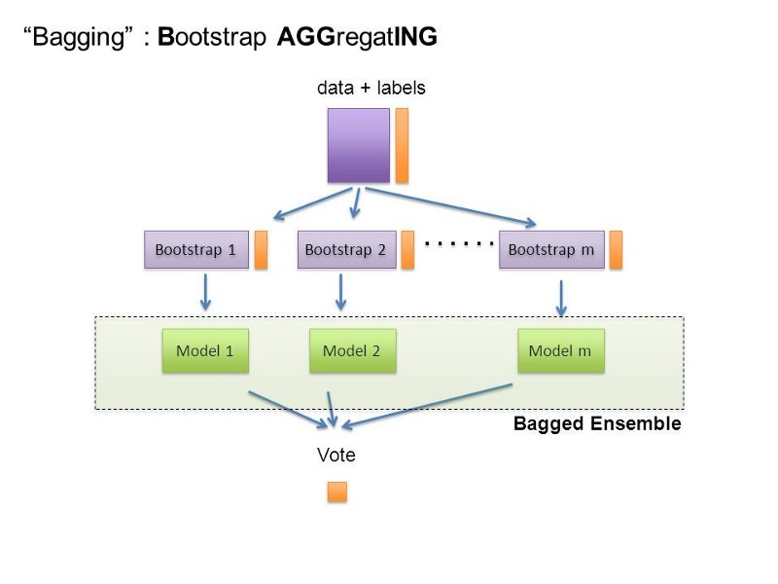
Copyright © www.ITbodhi.com

Slide 9
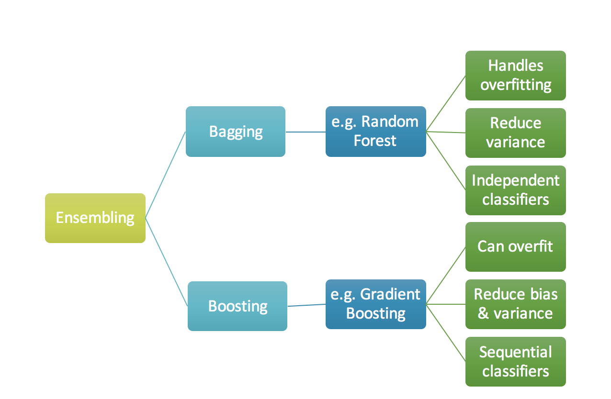
Copyright © www.ITbodhi.com

Slide 10
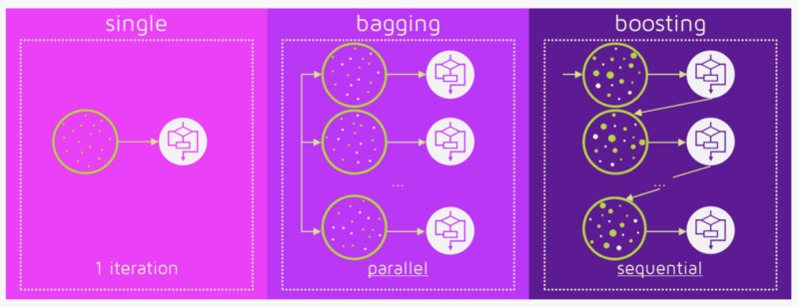
Copyright © www.ITbodhi.com

Slide 11
Boosting algorithms are a set of the low accurate classifier to create a highly accurate classifier.

Slide 12
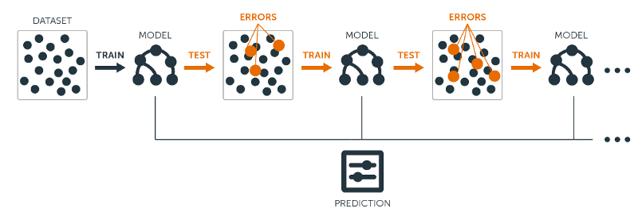
Copyright © www.ITbodhi.com

Slide 13
ADA Boost
Adaptive Boosting
Copyright © www.ITbodhi.com

Slide 14
First practical boosting algorithm proposed by Freund and Schapire in 1996. It focuses on classification problems and aims to convert a set of weak classifiers into a strong one
A single algorithm may classify the objects poorly. But if we combine multiple classifiers with selection of training set at every iteration and assigning right amount of weight in final voting, we can have good accuracy score for overall classifier.
Any machine learning algorithm can be used as base classifier if it accepts weights on the training set. AdaBoost uses Decision Tree Classifier as default Classifier. Support Vector Classifier can also be used.
AdaBoost can be used both for classification and regression problems : AdaBoostClassifier and AdaBoostRegressor
Copyright © www.ITbodhi.com

Slide 15
Loss Function
The loss function used depends on the type of problem being solved.
It must be differentiable, but many standard loss functions are supported and you can define your own.
For example, regression may use a squared error and classification may use logarithmic loss.
gradient is used to minimize a loss function
Copyright © www.ITbodhi.com

Slide 16
Weak Learner
Decision trees are used as the weak learner in gradient boosting.
Specifically regression trees are used that output real values for splits and whose output can be added together, allowing subsequent models outputs to be added and “correct” the residuals in the predictions.
Trees are constructed in a greedy manner, choosing the best split points based on purity scores like Gini index or Information gain to minimize the loss.
Copyright © www.ITbodhi.com

Slide 17
Additive Model
.
Trees are added one at a time, and existing trees in the model are not changed
A gradient descent procedure is used to minimize the loss when adding trees.
Copyright © www.ITbodhi.com

Slide 18
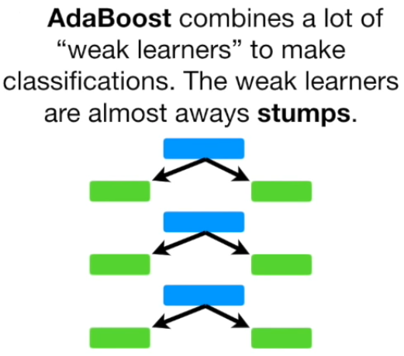
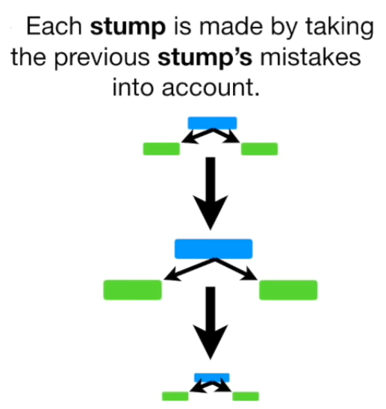
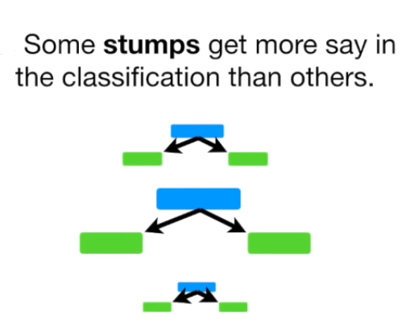
Copyright © www.ITbodhi.com

Slide 19
How do we select the training set?
Each weak classifier is trained using a random subset of overall training set.
Random subset is not actually 100% random. After training a classifier at any level, ada-boost assigns weight to each training item.
Misclassified item is assigned higher weight so that it appears in the training subset of next classifier with higher probability.
After each classifier is trained, the weight is assigned to the classifier as well based on accuracy.
More accurate classifier is assigned higher weight so that it will have more impact in final outcome.
Copyright © www.ITbodhi.com

Slide 20
How to assign weight to each classifier?
For any classifier with accuracy higher than 50%, the weight is positive.
The more accurate the classifier, the larger the weight.
Classifier with less than 50% accuracy, the weight is negative.
Copyright © www.ITbodhi.com

Slide 21
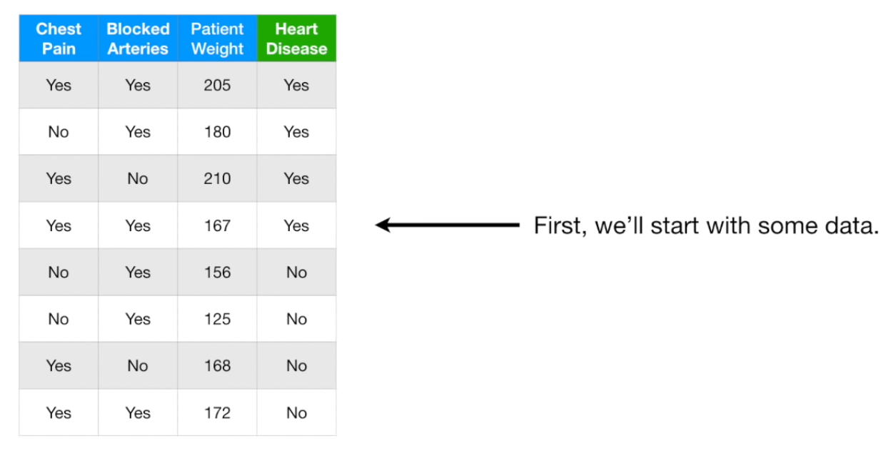
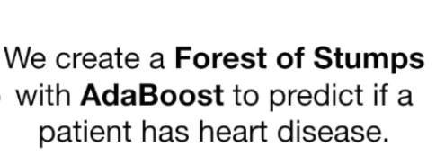
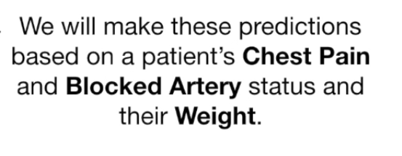
Copyright © www.ITbodhi.com

Slide 22
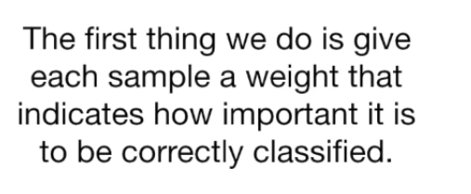
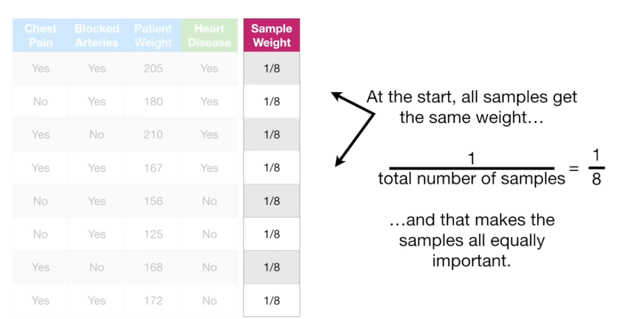
Copyright © www.ITbodhi.com

Slide 23
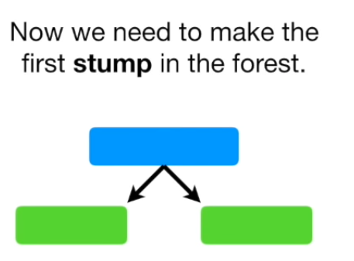
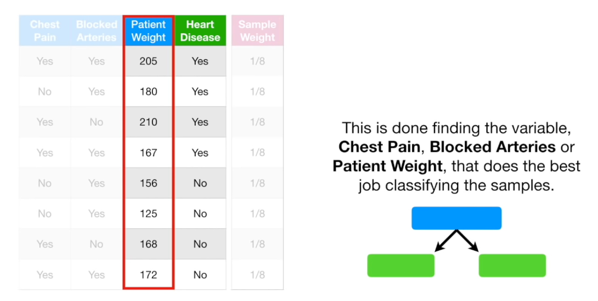
Copyright © www.ITbodhi.com

Slide 24
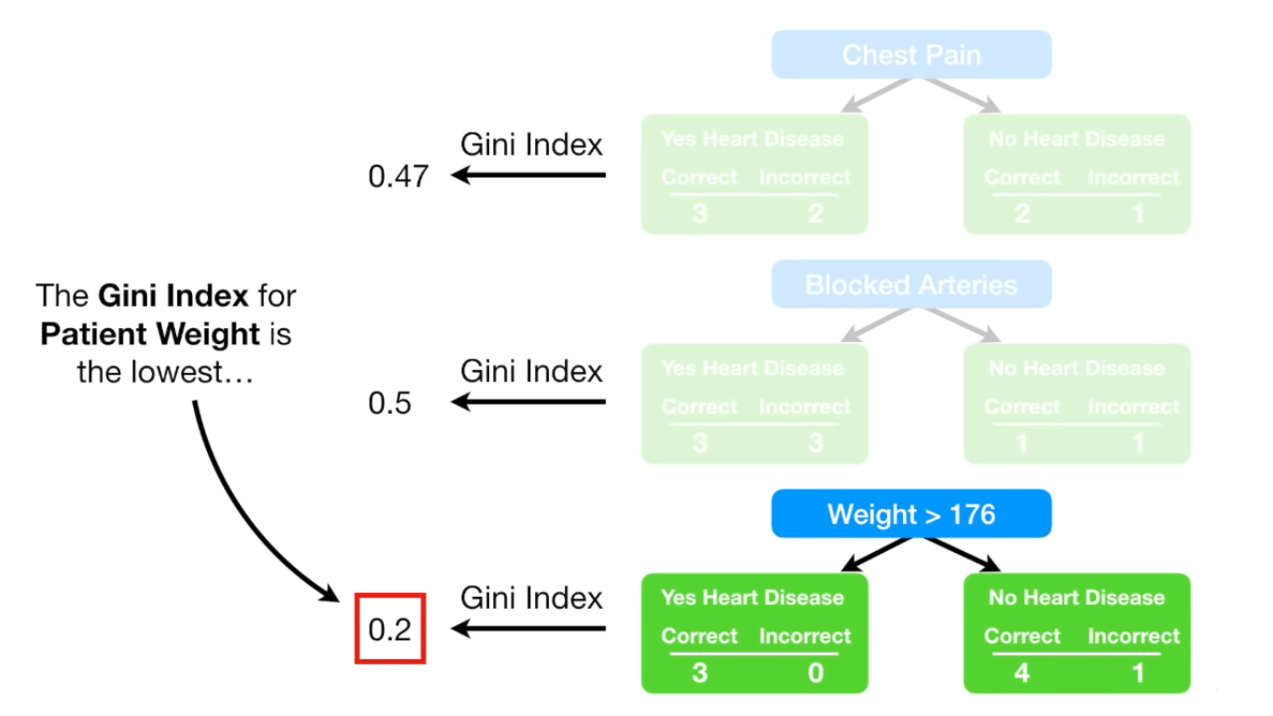
Copyright © www.ITbodhi.com

Slide 25
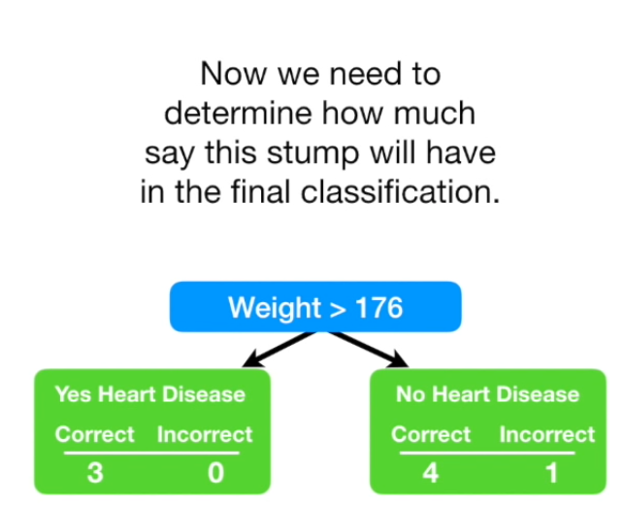
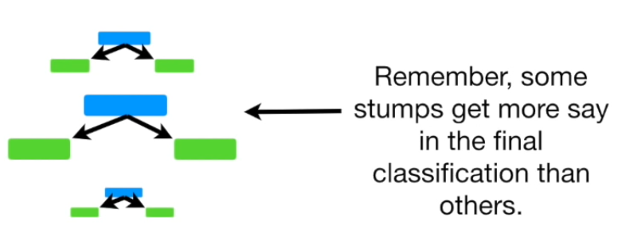
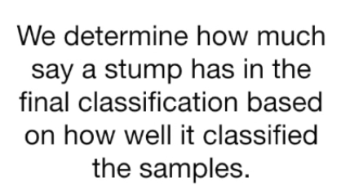
Copyright © www.ITbodhi.com

Slide 26
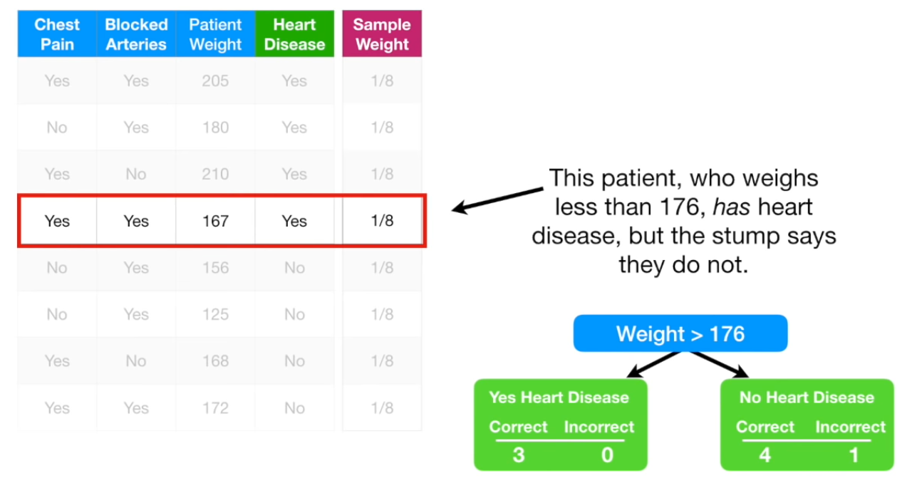
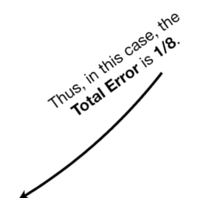
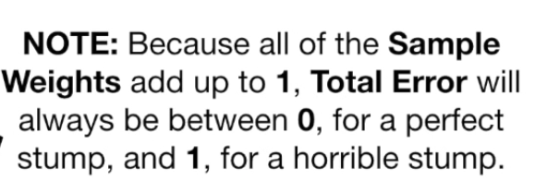
Copyright © www.ITbodhi.com

Slide 27
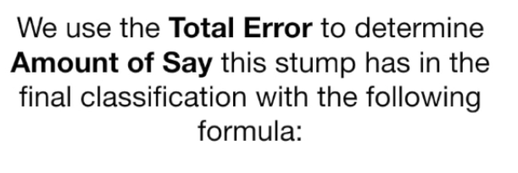
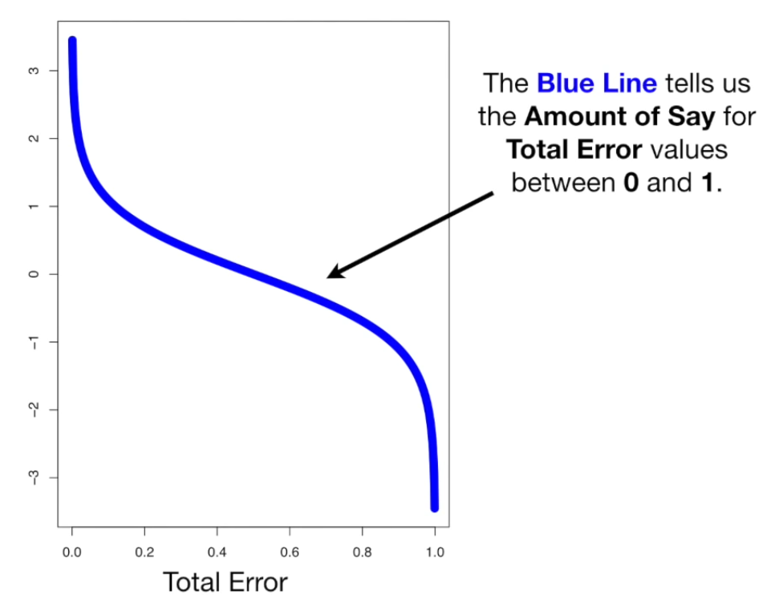
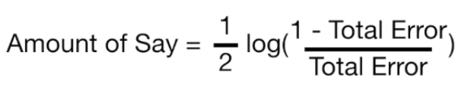
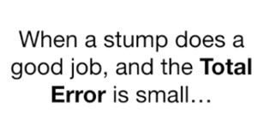
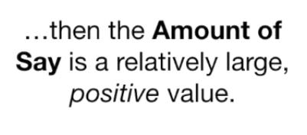
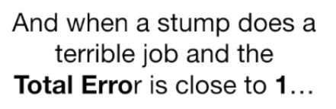
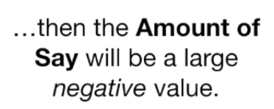
Copyright © www.ITbodhi.com

Slide 28
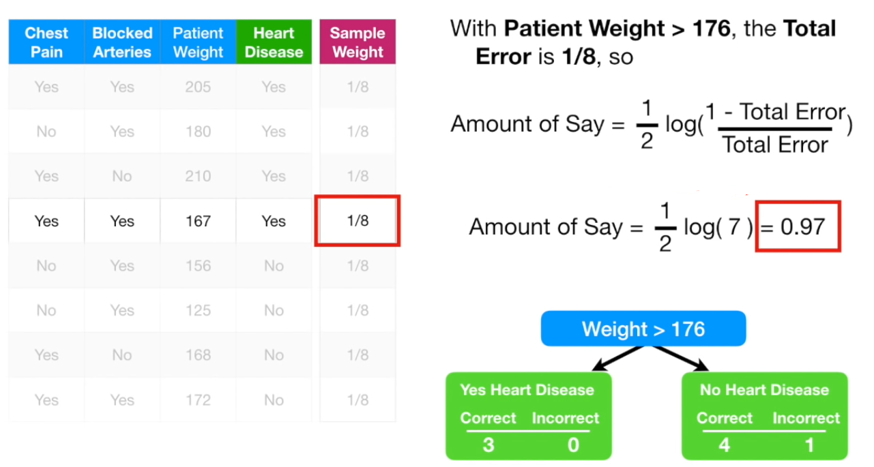
Copyright © www.ITbodhi.com

Slide 29
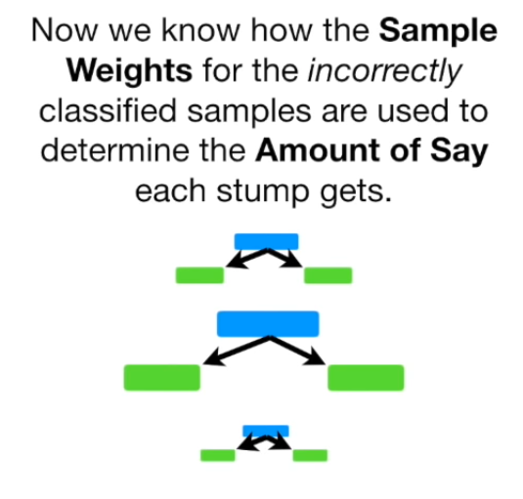
Copyright © www.ITbodhi.com

Slide 30
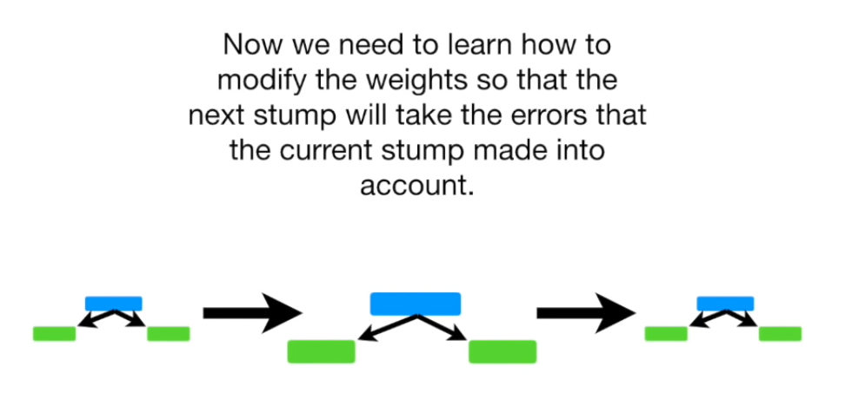
Copyright © www.ITbodhi.com

Slide 31
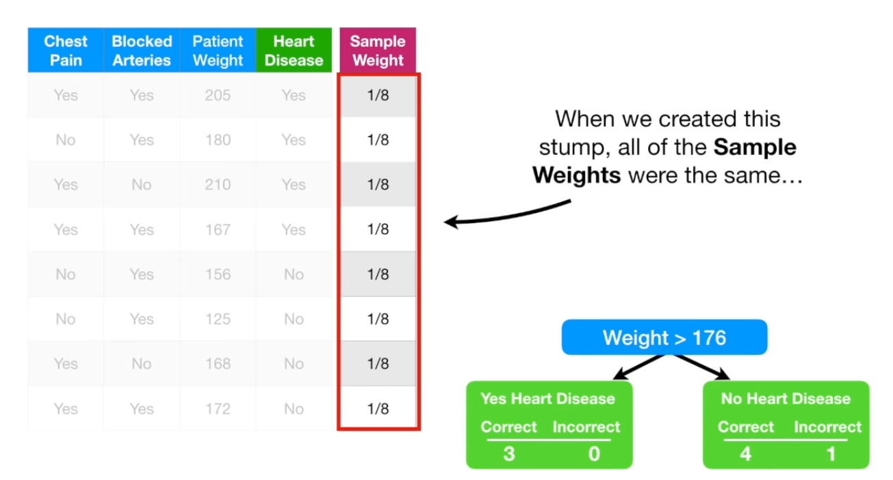
Copyright © www.ITbodhi.com

Slide 32
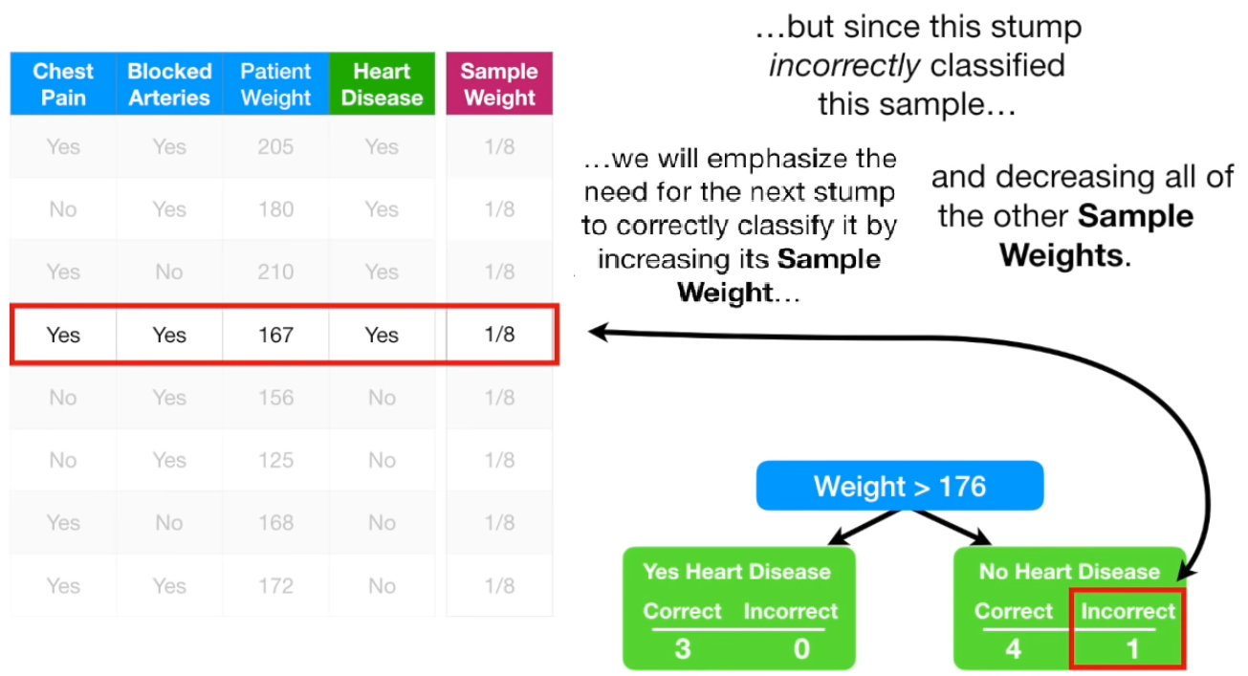
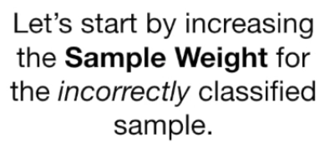
Copyright © www.ITbodhi.com

Slide 33
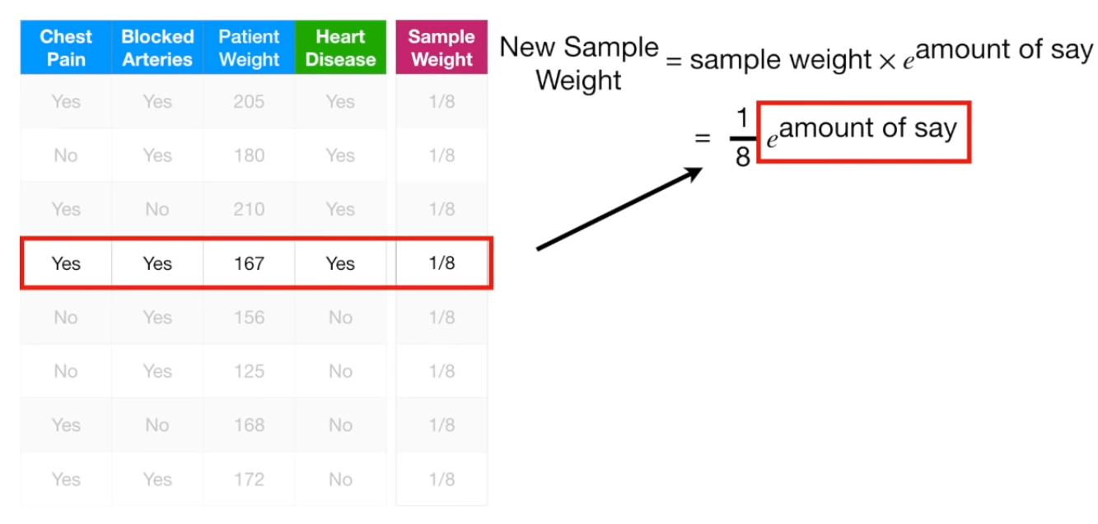
Copyright © www.ITbodhi.com

Slide 34
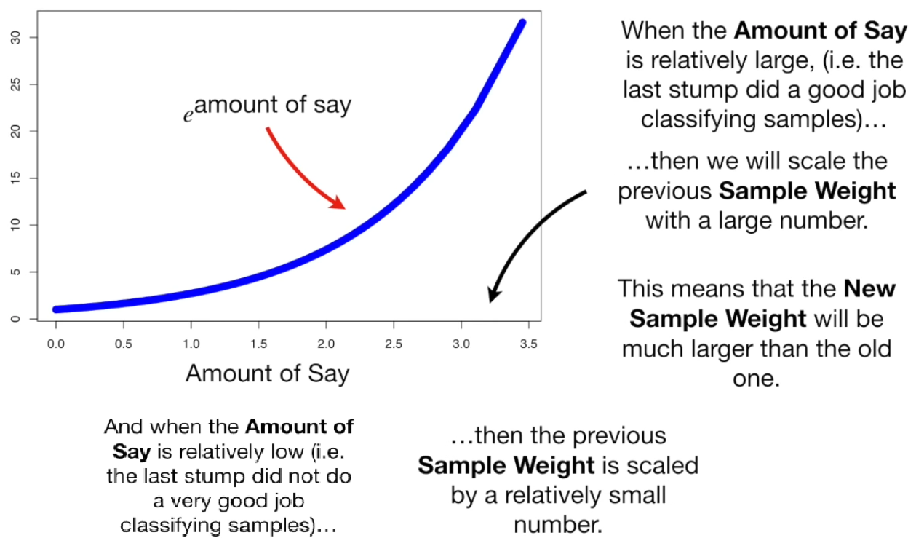
Copyright © www.ITbodhi.com

Slide 35
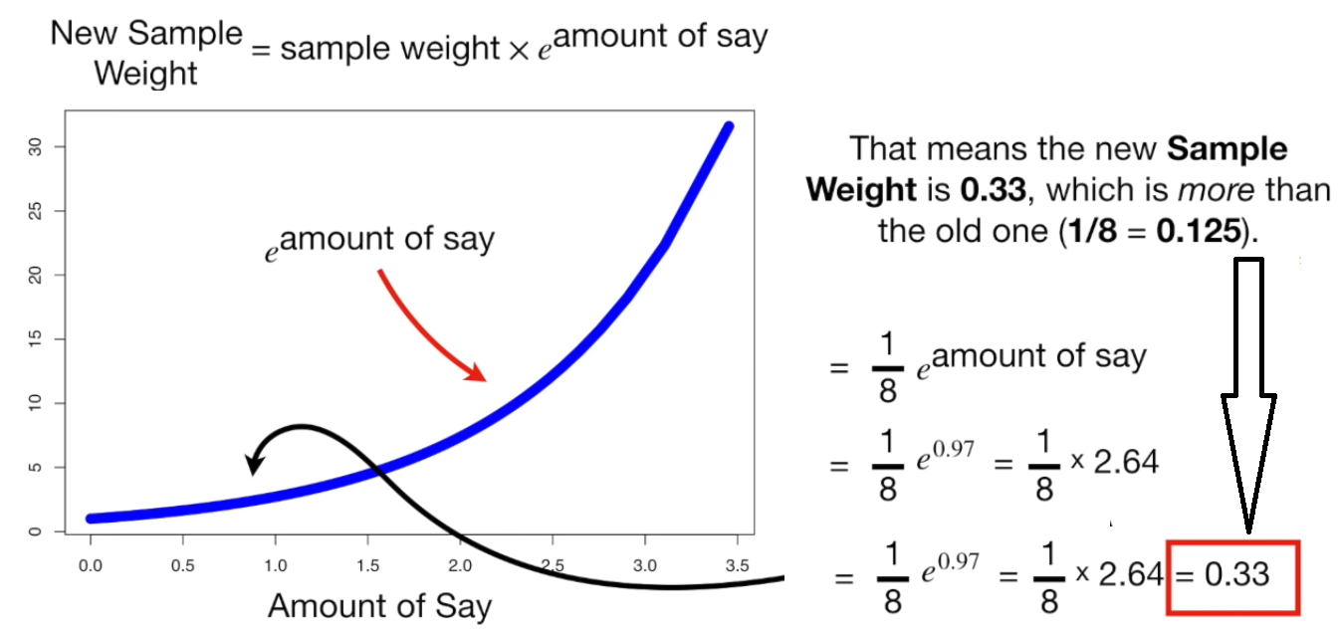
Copyright © www.ITbodhi.com

Slide 36
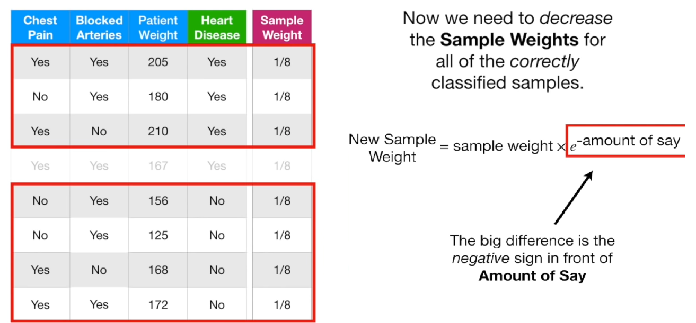
Copyright © www.ITbodhi.com

Slide 37
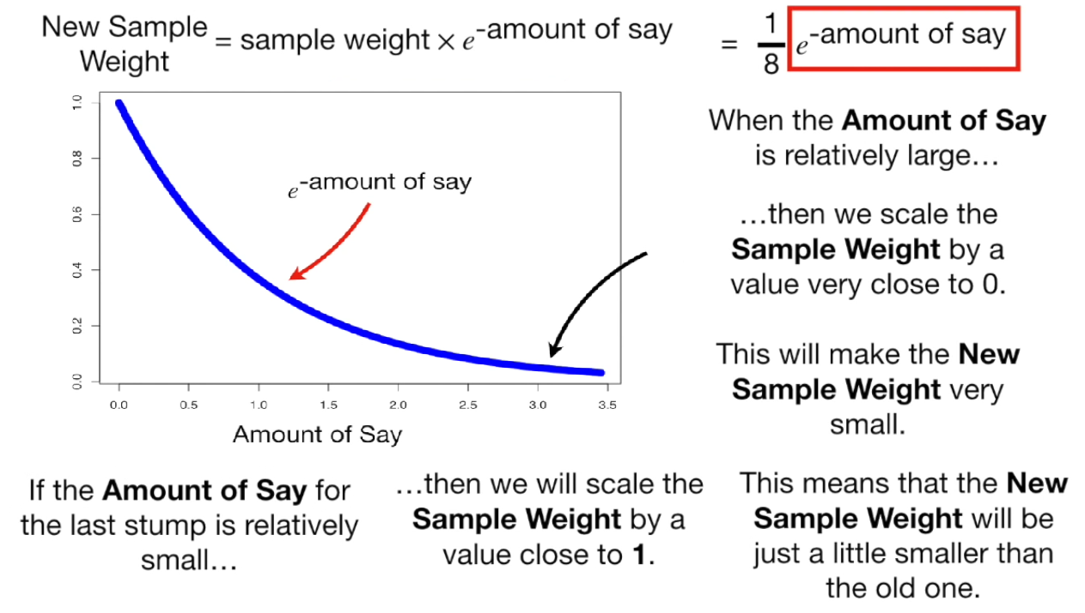
Copyright © www.ITbodhi.com

Slide 38
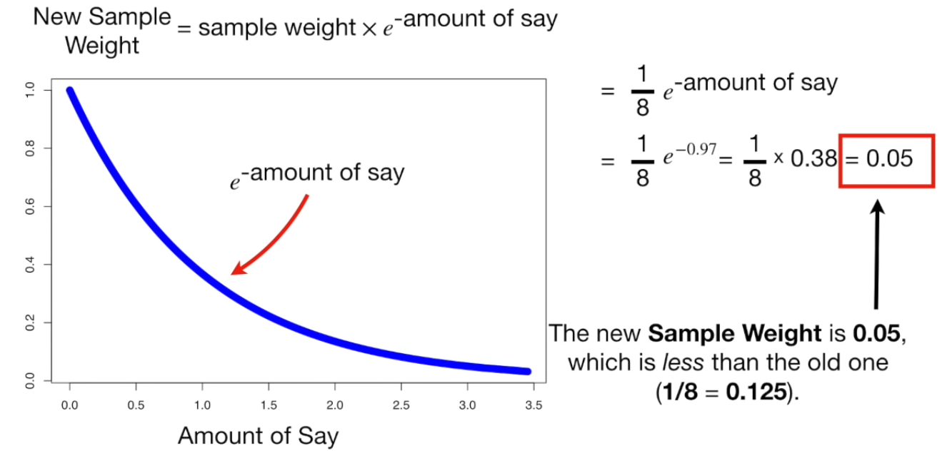
Copyright © www.ITbodhi.com

Slide 39
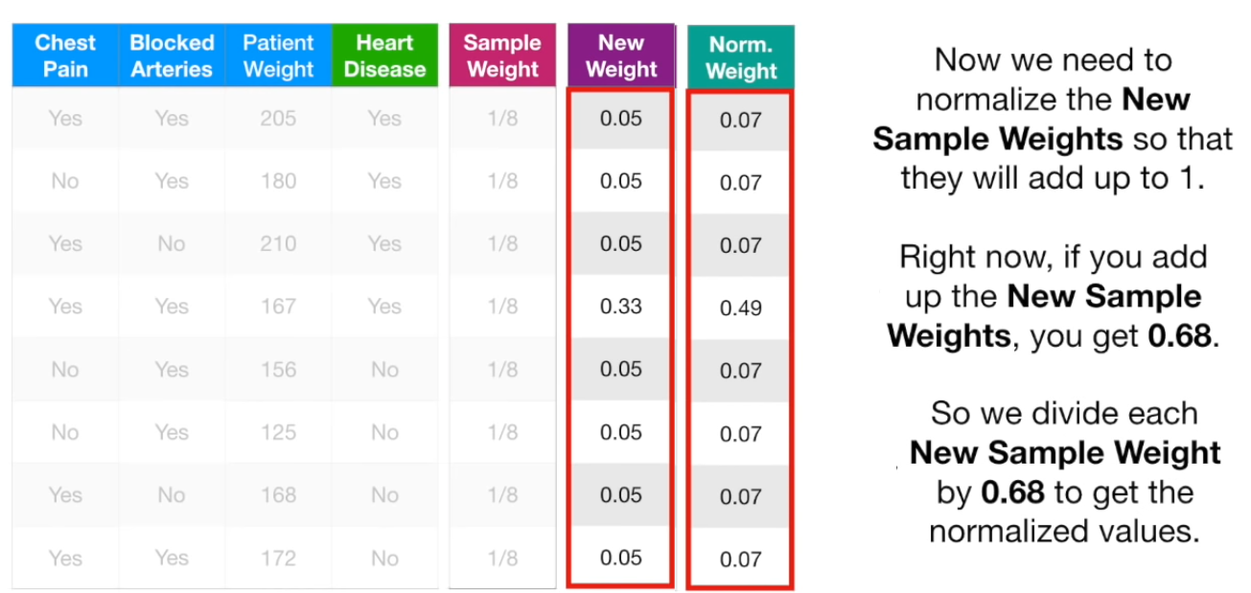
Copyright © www.ITbodhi.com

Slide 40
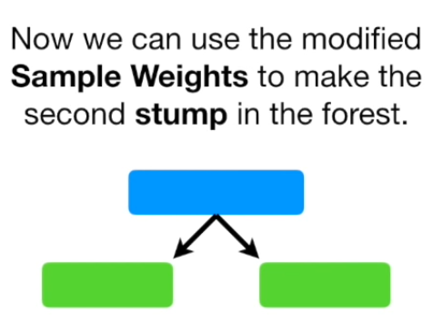
Copyright © www.ITbodhi.com

Slide 41
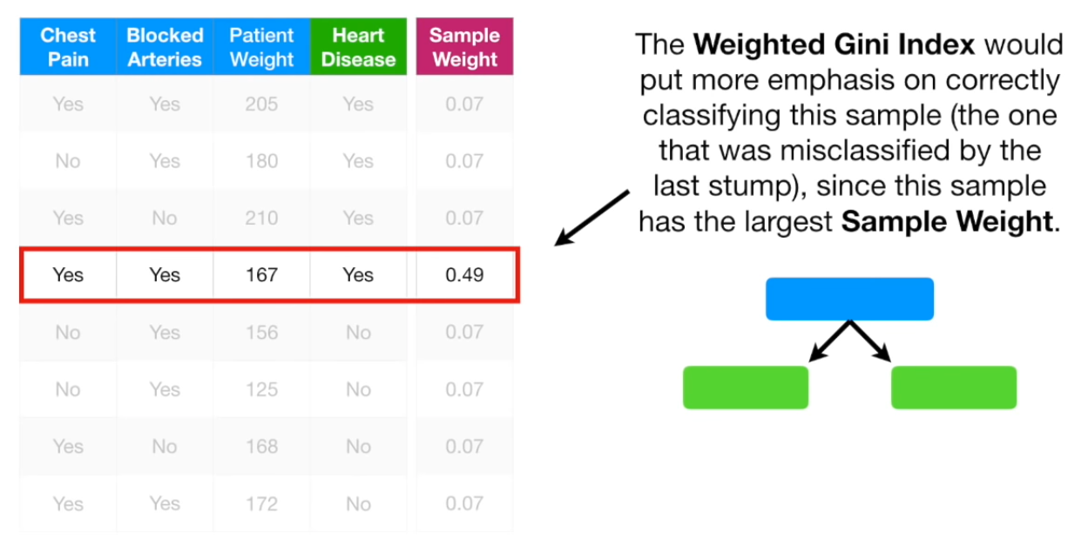
Copyright © www.ITbodhi.com

Slide 42
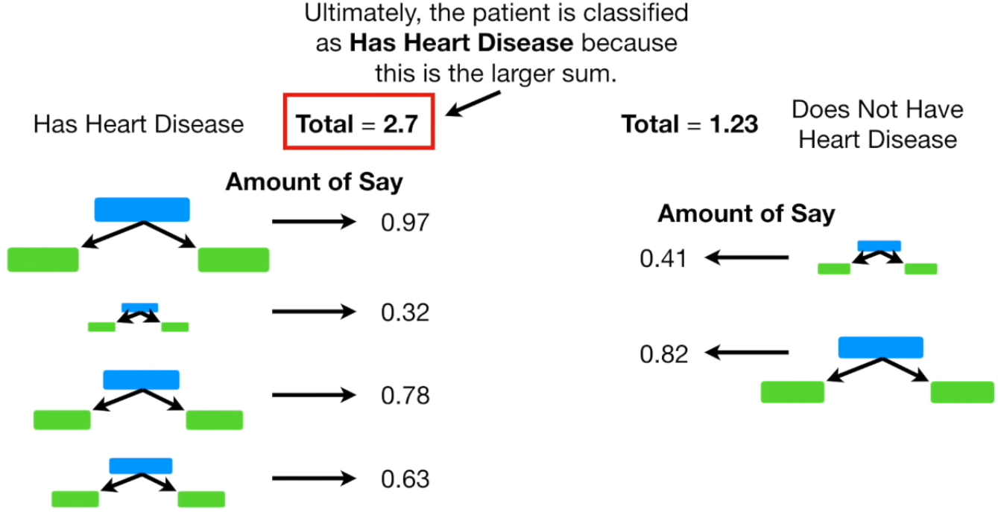
Copyright © www.ITbodhi.com

Slide 43
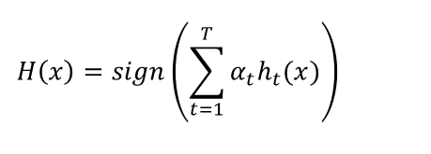
The final equation for classification can be represented as:
h_t(x) is the output of weak classifier t for input x
alpha_t is weight assigned to classifier.
alpha_t is calculated as follows:
alpha_t = 0.5 * ln( (1 — E)/E) : weight of classifier is straight forward, it is based on the error rate E.
It is exactly the weighted combination of M weak classifiers.
Copyright © www.ITbodhi.com

Slide 44
AdaBoost algorithm
Initially, all the input training example has equal weightage. i.e 1/N
Initially, Adaboost selects a training subset randomly.
After weak classifier is trained (select the one with the lowest weighted classification error)
Calculate the weight for the m_th weak classifier
Now update the weight of each training example
After M iteration we can get the final prediction by summing up the weighted prediction of each classifier.
Copyright © www.ITbodhi.com

Slide 45
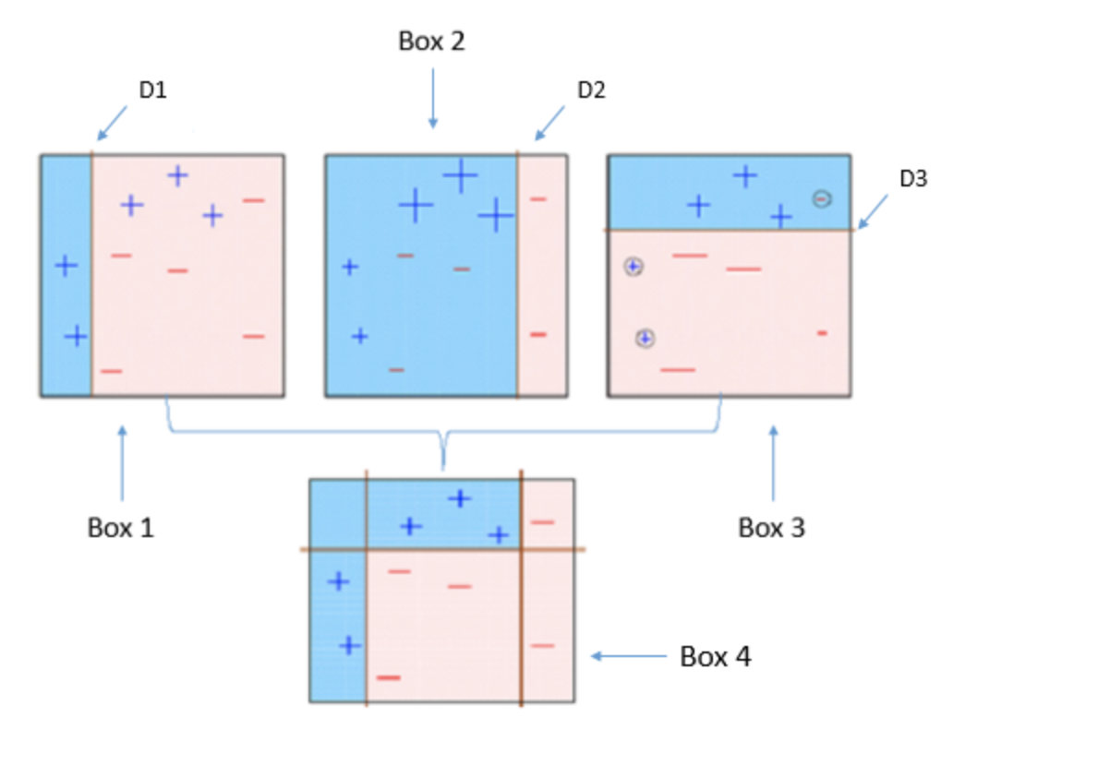
Copyright © www.ITbodhi.com

Slide 46
Box 1: You can see that we have assigned equal weights to each data point and applied a decision stump to classify them as + (plus) or — (minus). The decision stump (D1) has generated vertical line at left side to classify the data points. We see that, this vertical line has incorrectly predicted three + (plus) as — (minus). In such case, we’ll assign higher weights to these three + (plus) and apply another decision stump.
Box 2: Here, you can see that the size of three incorrectly predicted + (plus) is bigger as compared to rest of the data points. In this case, the second decision stump (D2) will try to predict them correctly. Now, a vertical line (D2) at right side of this box has classified three mis-classified + (plus) correctly. But again, it has caused mis-classification errors. This time with three -(minus). Again, we will assign higher weight to three — (minus) and apply another decision stump.
Box 3: Here, three — (minus) are given higher weights. A decision stump (D3) is applied to predict these mis-classified observation correctly. This time a horizontal line is generated to classify + (plus) and — (minus) based on higher weight of mis-classified observation.
Box 4: Here, we have combined D1, D2 and D3 to form a strong prediction having complex rule as compared to individual weak learner. You can see that this algorithm has classified these observation quite well as compared to any of individual weak learner.
Copyright © www.ITbodhi.com

Slide 47
Below are the steps for performing the AdaBoost algorithm:
Initially, all observations are given equal weights.
A model is built on a subset of data.
Using this model, predictions are made on the whole dataset.
Errors are calculated by comparing the predictions and actual values.
While creating the next model, higher weights are given to the data points which were predicted incorrectly.
Weights can be determined using the error value. For instance, the higher the error the more is the weight assigned to the observation.
This process is repeated until the error function does not change, or the maximum limit of the number of estimators is reached.
Copyright © www.ITbodhi.com

Slide 48
Hyperparameters
base_estimators: specifies the base type estimator, i.e. the algorithm to be used as base learner.
n_estimators: It defines the number of base estimators, where the default is 10 but you can increase it in order to obtain a better performance.
learning_rate : same impact as in gradient descent algorithm
max_depth : Maximum depth of the individual estimator
Copyright © www.ITbodhi.com

Slide 49
Pros
AdaBoost is easy to implement.
It iteratively corrects the mistakes of the weak classifier and improves accuracy by combining weak learners.
You can use many base classifiers with AdaBoost.
AdaBoost is not prone to over-fitting. This can be found out via experiment results, but there is no concrete reason available.
Cons
AdaBoost is sensitive to noise data.
It is highly affected by outliers because it tries to fit each point perfectly.
AdaBoost is slower compared to XGBoost.
Copyright © www.ITbodhi.com

Slide 50
Gradient Boosting
Copyright © www.ITbodhi.com

Slide 51
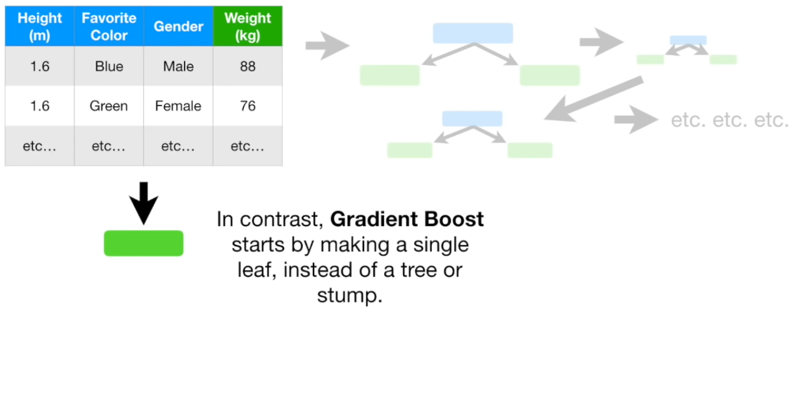
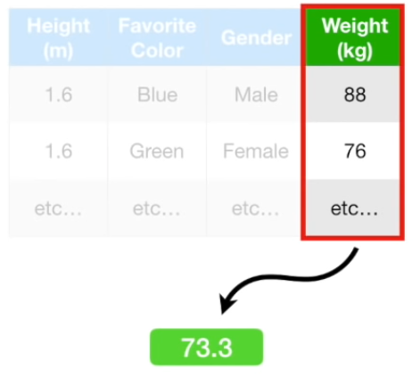


Copyright © www.ITbodhi.com

Slide 52






Copyright © www.ITbodhi.com

Slide 53





Copyright © www.ITbodhi.com

Slide 54





Copyright © www.ITbodhi.com

Slide 55


Copyright © www.ITbodhi.com

Slide 56




Copyright © www.ITbodhi.com

Slide 57


Copyright © www.ITbodhi.com

Slide 58


Copyright © www.ITbodhi.com

Slide 59

Copyright © www.ITbodhi.com

Slide 60








Copyright © www.ITbodhi.com

Slide 61

Copyright © www.ITbodhi.com

Slide 62


Copyright © www.ITbodhi.com

Slide 63


Copyright © www.ITbodhi.com

Slide 64

Copyright © www.ITbodhi.com

Slide 65

Copyright © www.ITbodhi.com

Slide 66

Copyright © www.ITbodhi.com

Slide 67

Copyright © www.ITbodhi.com

Slide 68

Copyright © www.ITbodhi.com

Slide 69

Copyright © www.ITbodhi.com

Slide 70

Copyright © www.ITbodhi.com

Slide 71


Copyright © www.ITbodhi.com

Slide 72

Copyright © www.ITbodhi.com

Slide 73

Copyright © www.ITbodhi.com

Slide 74

Copyright © www.ITbodhi.com

Slide 75

Copyright © www.ITbodhi.com

Slide 76


Copyright © www.ITbodhi.com

Slide 77

Copyright © www.ITbodhi.com

Slide 78
Gradient Descent Boosting Mathematics
Copyright © www.ITbodhi.com

Slide 79


Copyright © www.ITbodhi.com

Slide 80
Gradient Boosting works by sequentially adding the previous predictors under-fitted predictions to the ensemble, ensuring the errors made previously are corrected.
The difference lies in what it does with the underfitted values of its predecessor. Contrary to AdaBoost, which tweaks the instance weights at every interaction, this method tries to fit the new predictor to the residual errors made by the previous predictor.
Copyright © www.ITbodhi.com

Slide 81
Gradient boosting is a machine learning technique for regression and classification problems, which produces a prediction model in the form of an ensemble of weak prediction models, typically decision trees.
The objective of any supervised learning algorithm is to define a loss function and minimize it.
Copyright © www.ITbodhi.com

Slide 82
Gradient Boosting
Pros:
Natural handling of data of mixed type (= heterogeneous features)
Predictive power
Robustness to outliers in output space
Cons:
Scalability, due to the sequential nature of boosting it can hardly be parallelized.
Copyright © www.ITbodhi.com

Slide 83
Below are the steps for performing the Gradient Boosting algorithm:
A model is built on a subset of data.
Using this model, predictions are made on the whole dataset.
Errors are calculated by comparing the predictions and actual values.
A new model is created using the errors calculated as target variable. Our objective is to find the best split to minimize the error.
The predictions made by this new model are combined with the predictions of the previous.
New errors are calculated using this predicted value and actual value.
This process is repeated until the error function does not change, or the maximum limit of the number of estimators is reached.
Copyright © www.ITbodhi.com

Slide 84
We are basically updating the predictions such that the sum of our residuals is close to 0 (or minimum) and predicted values are sufficiently close to actual values.
Copyright © www.ITbodhi.com

Slide 85

Intuition behind Gradient Boosting
A basic assumption of linear regression is that sum of its residuals is 0, i.e. the residuals should be spread randomly around zero.
Copyright © www.ITbodhi.com

Slide 86
Now think of these residuals as mistakes committed by our predictor model, we might argue that, if we are able to see some pattern of residuals around 0, we can leverage that pattern to fit a model.
So, the intuition behind gradient boosting algorithm is to repetitively leverage the patterns in residuals and strengthen a model with weak predictions and make it better.
Once we reach a stage that residuals do not have any pattern that could be modeled, we can stop modeling residuals (otherwise it might lead to overfitting). Algorithmically, we are minimizing our loss function, such that test loss reach its minima.
Copyright © www.ITbodhi.com

Slide 87
In summary,
• We first model data with simple models and analyze data for errors. • These errors signify data points that are difficult to fit by a simple model. • Then for later models, we particularly focus on those hard to fit data to get them right. • In the end, we combine all the predictors by giving some weights to each predictor.
Copyright © www.ITbodhi.com

Slide 88

Steps to fit a Gradient Boosting model
Let’s consider simulated data as shown in scatter plot below with 1 input (x) and 1 output (y) variables.
Copyright © www.ITbodhi.com

Slide 89
Fit a simple linear regressor or decision tree on data [call x as input and y as output]
Calculate error residuals. Actual target value, minus predicted target value [e1= y - y_predicted1 ]
Fit a new model on error residuals as target variable with same input variables [call it e1_predicted]
Add the predicted residuals to the previous predictions [y_predicted2 = y_predicted1 + e1_predicted]
Fit another model on residuals that is still left. i.e. [e2 = y - y_predicted2] and repeat steps 2 to 5 until it starts overfitting or the sum of residuals become constant. Overfitting can be controlled by consistently checking accuracy on validation data.
Copyright © www.ITbodhi.com

Slide 90
Visualization of working Gradient Boosting Tree
Blue dots (left) plots are input (x) vs. output (y) • Red line (left) shows values predicted by decision tree • Green dots (right) shows residuals vs. input (x) for ith iteration • Iteration represent sequential order of fitting gradient boosting tree
Copyright © www.ITbodhi.com

Slide 91

Copyright © www.ITbodhi.com

Slide 92


Copyright © www.ITbodhi.com

Slide 93

Copyright © www.ITbodhi.com

Slide 94

We observe that after 20th iteration , residuals are randomly distributed around 0 and our predictions are very close to true values.
(iterations are called n_estimators in sklearn implementation). This would be a good point to stop or our model will start overfitting.
Let’s see how our model look like for 50th iteration.
Copyright © www.ITbodhi.com

Slide 95

Copyright © www.ITbodhi.com

Slide 96





Copyright © www.ITbodhi.com

Slide 97





Copyright © www.ITbodhi.com

Slide 98




Copyright © www.ITbodhi.com

Slide 99


Copyright © www.ITbodhi.com

Slide 100



Copyright © www.ITbodhi.com

Slide 101

Copyright © www.ITbodhi.com

Slide 102


Copyright © www.ITbodhi.com

Slide 103




Copyright © www.ITbodhi.com

Slide 104

Copyright © www.ITbodhi.com

Slide 105





Copyright © www.ITbodhi.com

Slide 106

Copyright © www.ITbodhi.com

Slide 107
Copyright © www.ITbodhi.com

Slide 108

Copyright © www.ITbodhi.com

Slide 109


Copyright © www.ITbodhi.com

Slide 110





Copyright © www.ITbodhi.com

Slide 111


Copyright © www.ITbodhi.com

Slide 112

Copyright © www.ITbodhi.com

Slide 113

Copyright © www.ITbodhi.com

Slide 114

Copyright © www.ITbodhi.com

Slide 115

Copyright © www.ITbodhi.com

Slide 116


Copyright © www.ITbodhi.com

Slide 117

Copyright © www.ITbodhi.com

Slide 118
XGBoost stands for eXtreme Gradient Boosting.
It is an implementation of gradient boosting machines created by Tianqi Chen.
XGBoost is an algorithm that has recently been dominating applied machine learning and Kaggle competitions for structured or tabular data.
Open Source
Copyright © www.ITbodhi.com

Slide 119
Model Features
The implementation of the model supports the features of the scikit-learn and R implementations, with new additions like regularization. Three main forms of gradient boosting are supported:
Gradient Boosting algorithm also called gradient boosting machine including the learning rate.
Stochastic Gradient Boosting with sub-sampling at the row, column and column per split levels.
Regularized Gradient Boosting with both L1 and L2 regularization.
Copyright © www.ITbodhi.com

Slide 120
System Features
The library provides a system for use in a range of computing environments, not least:
Parallelization of tree construction using all of your CPU cores during training.
Distributed Computing for training very large models using a cluster of machines.
Out-of-Core Computing for very large datasets that don’t fit into memory.
Cache Optimization of data structures and algorithm to make best use of hardware.
Copyright © www.ITbodhi.com

Slide 121
Algorithm Features
The implementation of the algorithm was engineered for efficiency of compute time and memory resources. A design goal was to make the best use of available resources to train the model. Some key algorithm implementation features include:
Sparse Aware implementation with automatic handling of missing data values.
Block Structure to support the parallelization of tree construction.
Continued Training so that you can further boost an already fitted model on new data.
Copyright © www.ITbodhi.com

Slide 122

XGBoost Execution Speed
Generally, XGBoost is fast. Really fast when compared to other implementations of gradient boosting.
Copyright © www.ITbodhi.com

Slide 123
XGBoost Model Performance
XGBoost dominates structured or tabular datasets on classification and regression predictive modeling problems.
“When in doubt, use xgboost”
Copyright © www.ITbodhi.com

Slide 124
XGBoost's hyperparameters: Most Commonly used
learning_rate: step size shrinkage used to prevent overfitting. Range is [0,1]
max_depth: determines how deeply each tree is allowed to grow during any boosting round.
subsample: percentage of samples used per tree. Low value can lead to underfitting.
colsample_bytree: percentage of features used per tree. High value can lead to overfitting.
n_estimators: number of trees you want to build.
objective: determines the loss function to be used like reg:linear for regression problems, reg:logistic for classification problems with only decision, binary:logistic for classification problems with probability.
Copyright © www.ITbodhi.com

Slide 125
XGBoost also supports regularization parameters to penalize models as they become more complex and reduce them to simple models.
gamma: controls whether a given node will split based on the expected reduction in loss after the split. A higher value leads to fewer splits. Supported only for tree-based learners.
alpha: L1 regularization on leaf weights. A large value leads to more regularization.
lambda: L2 regularization on leaf weights and is smoother than L1 regularization.
Copyright © www.ITbodhi.com

Slide 126
You are using trees as your base learners, you can also use XGBoost's relatively less popular linear base learners and one other tree learner known as dart.
booster [default= gbtree ]
Which booster to use. Can be gbtree, gblinear or dart; gbtree and dart use tree based models while gblinear uses linear functions.
Copyright © www.ITbodhi.com

Slide 127
pip install xgboost
Copyright © www.ITbodhi.com

